Slide 1

Ensembles using Bagging and Boosting

Slide 2
How to address Overfitting caused by complex trees?
Pre-Pruning (Early Stopping Rule)
Stop the algorithm before it becomes a fully-grown tree based on various stopping conditions (same class instances, same attribute values, thresholding for number of a minimum number of instances in a split, impurity score margins)
Post-pruning
Grow decision tree to its entirety and trim the nodes of the decision tree in a bottom-up fashion.
Replace sub-tree with a leaf node wherever generalization error improves, or use cost-complexity measures to prune
Ensembles
Combining the outcome of multiple models
Generate multiple decision trees using a random selection of attributes at each node to determine the split.
During classification, each tree votes and the most popular class is returned.

Slide 3
Ensembles
Combine forecasts from different methods by voting, averaging, etc.
Combine forecasts from multiple series measuring the same phenomenon (weather)
Multi-level models: fit one method to another method’s forecast errors
5

Slide 4
Why does an ensemble make more accurate predictions?
The key is reducing the variance in predictions.
Individual methods will produce predictions that have errors, some positive and some negative
If prediction methods are unbiased, on balance, errors tend to cancel each other out
An average of multiple predictions takes advantage of this canceling out and, most of the time, is more accurate than individual predictions
Ref: Data Mining for Business Analytics: Concepts, Techniques and Applications in R, by Galit Shmueli et al., Wiley India, 2018.

Slide 5
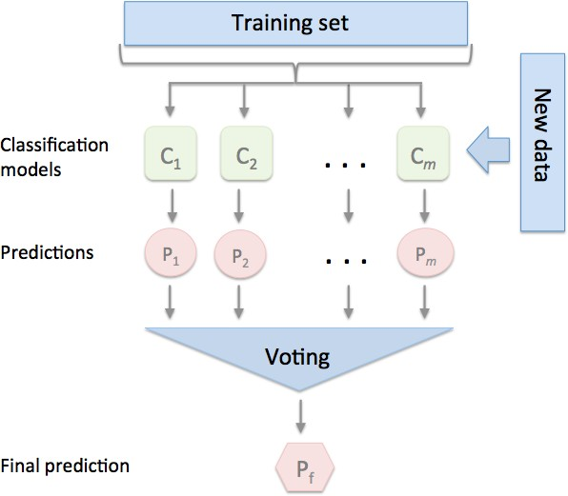
Ensemble Models
The goal behind ensemble methods is to combine different classifiers into a meta-classifier that has a better generalization performance than each individual classifier alone
Max Voting, Averaging, Weighted Averaging, Bagging, Boosting, Stacking, Blending
General ensemble
approach using majority voting
8

Slide 6
Advanced Ensemble Methods
Bagging
The idea behind bagging is combining the results of multiple models (for instance, all decision trees) to get a generalized result.
Boosting
Boosting is a sequential process, where each subsequent model attempts to correct the errors of the previous model.
The succeeding models are dependent on the previous model.
9
Source: https://www.analyticsvidhya.com/blog/2018/06/comprehensive-guide-for-ensemble-models/

Slide 7
Bagging
The idea behind bagging is to combine the output of multiple models (for instance, all decision trees) to get a generalized result.
Q: If you create all the models on the same set of data and combine it, will it be useful?
A: There is a high probability that these models will give the same output since they are getting
the same input.
Solution: Bootstrapping
Bootstrapping is a sampling technique in which we create subsets of observations from the original dataset, with replacement.
The size of the subsets is the same or less than the size of the original set.
10

Slide 8
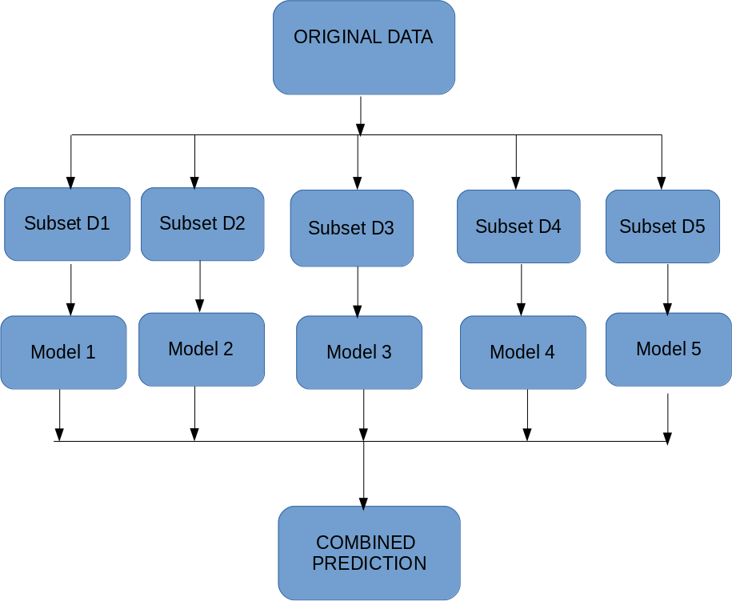
Bagging
Bagging (or Bootstrap Aggregating) technique uses these subsets (bags) to get a fair idea of the distribution (complete set).
The size of subsets created for bagging may be less than the original set.
However, instead of using the same training set to fit the individual classifiers in the ensemble, we draw bootstrap samples (random samples with replacement) from the initial training set, which is why bagging is also known as bootstrap aggregating
12
Source: https://www.analyticsvidhya.com/blog/2018/06/comprehensive-guide-for-ensemble-models/

Slide 9
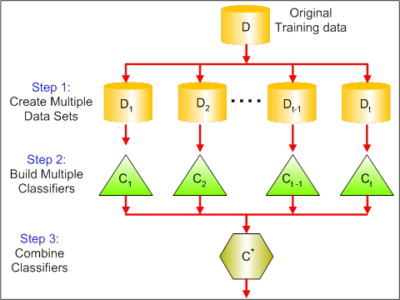
Bagging
Multiple subsets are created from the original dataset, selecting observations with replacement.
A base model (weak model) is created on each of these subsets.
The models run in parallel and are independent of each other.
The final predictions are determined by combining the predictions from all the models
13
Source: https://www.analyticsvidhya.com/blog/2018/06/comprehensive-guide-for-ensemble-models/

Slide 10
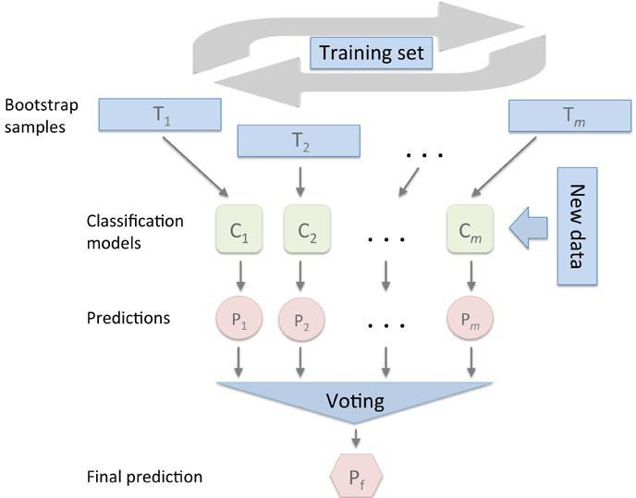
Bagging – building an ensemble of classifiers from bootstrap samples
In fact, random forests are a special case of bagging where we also use random feature subsets to fit the individual decision trees
Bagging can improve the accuracy of unstable models and decrease the degree of overfitting
Thus models of high variance can benefit out of Bagging techniques
Image Source: Python Machine Learning by Sebastian Raschka, Packt Publishing
14

Slide 11
Food for thought
If a data point is incorrectly predicted by the first model, and then by the subsequent models also, will combining the predictions provide better results?
Ans: No!
So how we do we solve this problem?
Boosting! Boosting is a sequential process, where each subsequent model attempts to correct the errors of the previous model. The succeeding models are dependent on the previous model.
15

Slide 12
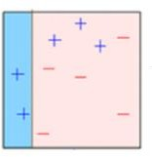
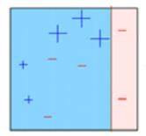
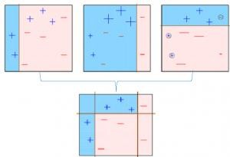
Boosting
A subset is created from the original dataset.
Initially, all data points are given
equal weights.
A base model is created on this subset.
This model is used to make
predictions on the whole dataset.
Errors are calculated using the
actual values and predicted values.
The observations which are incorrectly predicted, are given higher weights. (Here, the three misclassified blue-plus points will be given higher weights)
Another model is created and predictions are made on the dataset. (This model tries to correct the errors from the previous model)
Similarly, multiple models are created, each
correcting the errors of the previous model.
The final model (strong learner) is the weighted mean of all the models (weak learners).
Thus, the boosting algorithm combines a number of weak learners to form a strong learner.
The individual models would not perform well on the entire dataset, but they work well for some part of the dataset.
Thus, each model actually boosts the performance of the ensemble.
16

Slide 13
Bagging and Boosting Algorithms
Bagging algorithms:
Bagging meta-estimator
Random forest
Boosting algorithms:
AdaBoost
GBM
XGBM
Light GBM
CatBoost
18

Slide 14
Random Forests
Random Forest is an ensemble machine learning algorithm that follows bagging.
Random forest randomly selects a set of features which are used to decide the best split at each node of the decision tree.
Random forest randomly selects data points and features, and builds multiple trees (Forest)
Random Forest Algorithm
Random subsets are created from the original dataset (bootstrapping).
At each node in the decision tree, only a random set of features are considered to decide the best split.
A decision tree model is fitted on each of the subsets.
The final prediction is calculated by averaging the predictions from all decision trees.
20

Slide 15
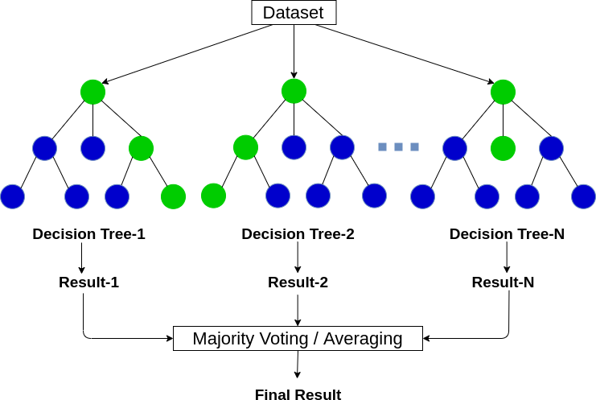
Random Forests – Advantages
Suited for both classification and regression
Can handle high-dimensional data and identify most significant variables using ‘Importance of Variable’ option (invoking the feature_importances_ on the random forest model and plotting it)
Effective method for estimating missing data and maintains accuracy when a large proportion of data is missing
Balancing errors in datasets where classes are imbalanced
Image Source: https://www.analyticsvidhya.com/blog/2020/05/decision-tree-vs-random-forest-algorithm/
21

Slide 16
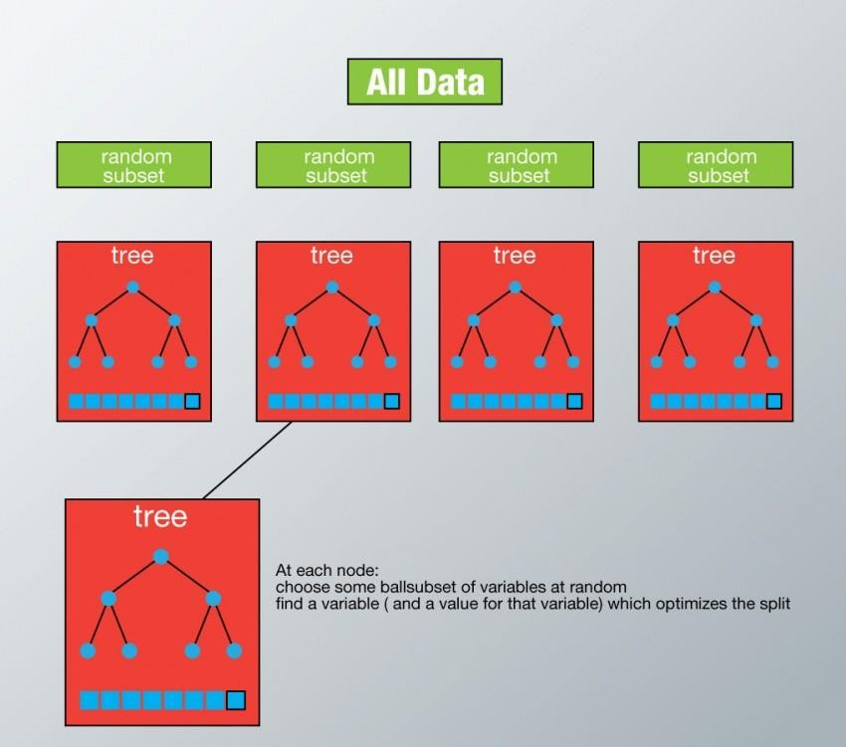
Random Forests – Disadvantages
Not very suited for precise continuous valued predictions.
In the case of regression, it might overfit.
Random forests is slow in generating predictions because it has multiple decision trees.
Whenever it makes a prediction, all the trees in the forest have to make a prediction for the same given input and then perform voting on it.
This whole process is time-consuming
Image Source: : Python Machine Learning by Sebastian Raschka, Packt Publishing
22

